Slide 1
EMPLOYEE MANAGEMENT PORTAL
--by Yashshree Rasal &
Shruti Hole

Slide 2
MCA – FY ADVANCE PROGRAMMING

Slide 3
Agenda
Introduction
TECHNOLOGIES
Flowchart
Libraries
OUTPUT

Slide 4
INTRODUCTION
The task is to create a Database-driven Employee Management System in Python that will store the information in the MySQL Database. The script will contain the following operations :
Add Employee
Remove Employee
Update Employee
Display Employees
This System works on the concepts of taking the information from the database making required changes in the fetched data and applying the changes in the record.

Slide 5
OBJECTIVE
The idea is that we perform different changes in our Employee Record by using different functions for example
Add_Employee will insert a new row in our Employee
Delete Employee Function which will delete the record of any particular existing employee in our Employee table.
We can also have the information about all the existing employees.
The main advantage of connecting our program to the database is that the information becomes lossless even after closing our program a number of times.

Slide 6
TECHNOLOGIES USED
Python
Tkinter
sqlite3

Slide 7
FEATURES
CREATE EMPLOYEE TABLE
1
LIST OF THE EMPLOYEE TABLE
2
UPDATE/SAVE ALL RECORDS
3
INSERT NEW ENTRY
4
UPDATE EXISTING ENTRY
5
DELETE THE ENTRY
6

Slide 8
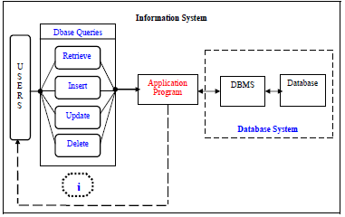
FLOWCHART

Slide 9
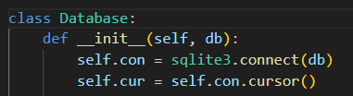
For creating the Employee Management Portal in Python that uses sqlite
database we need to connect Python with sqlite3.

Slide 10
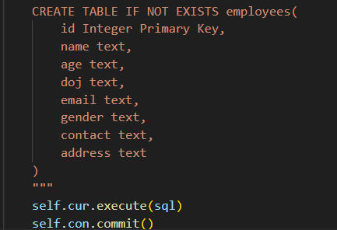
CRUD OPERATIONS ON TABLE
Create the Table

Slide 11
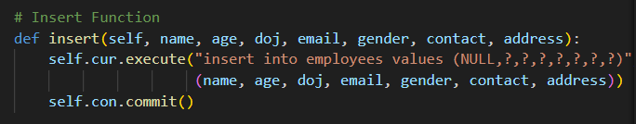
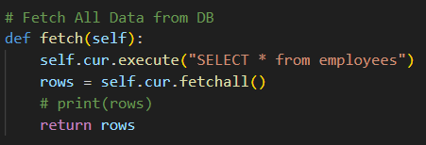
Insert Function
Fetch All data from DB

Slide 12
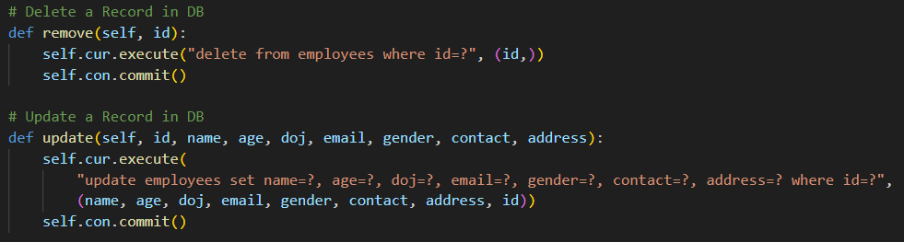
DELETE RECORD FROM TABLE
UPDATE A RECORD FROM TABLE

Slide 13
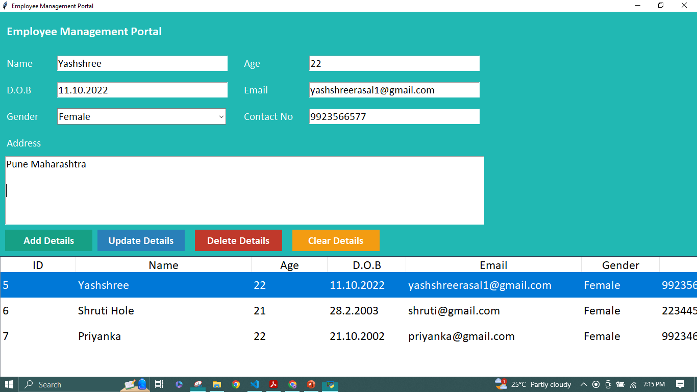
OUTPUT

Slide 14
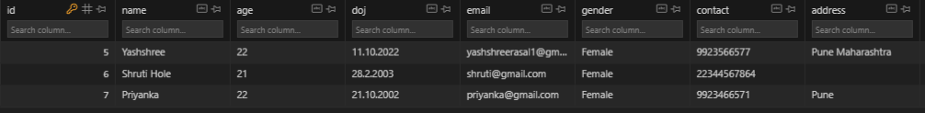
CRUD OPERATIONS :
TABLE OVERVIEW :

